Slide 1
Funny Dads Council
Emergency meeting

Slide 2
Opening Joke
Why should one never play poker in the jungle?
Dad Joke #1
It’s filled with too many cheetahs.

Slide 3
Problem Statement:
Are the Dads Among us Playing Poker?

Slide 4
Data Science Workflow
Web-Scraping
Data Cleaning
Feature Engineering
Cleaning and Pre-Processing
Modeling
Conclusions and Next Steps

Slide 5
Web Scraping
Scraping Tool Provided by Gwen Rathgeber and Ben Mathis
Scraped Two Subreddits
Dad Jokes
3,697 days worth of data collected
50,102 rows and 90 columns in our Raw Data Frame
Poker
5,395 days worth of data collected
50,234 rows and 99 columns in our Raw Data Frame

Slide 6
Data Cleaning
Column Reduction
Reduced from 90+ columns to 3
Self Text, Title, and Subreddit
Row Reduction
Dad Joke #2
Reduction Step | Poker | Dad Jokes
Initial | 50,234 | 50,102
Nulls | 29,948 | 48,613
High Value Counts | 27,405 | 47,378
Duplicates | 6,778 | 9,713

Slide 7
Feature Engineering
Tokenization
Sentiment Analysis
Lemmatization
Count Vectorization

Slide 8

EDA
Dad Joke #3

Slide 9
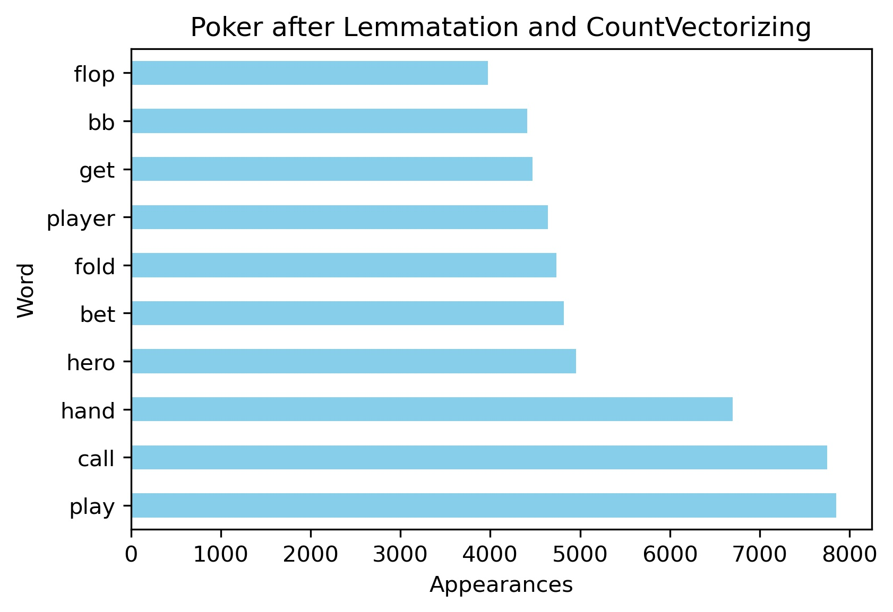
EDA – Feature Engineering

Slide 10
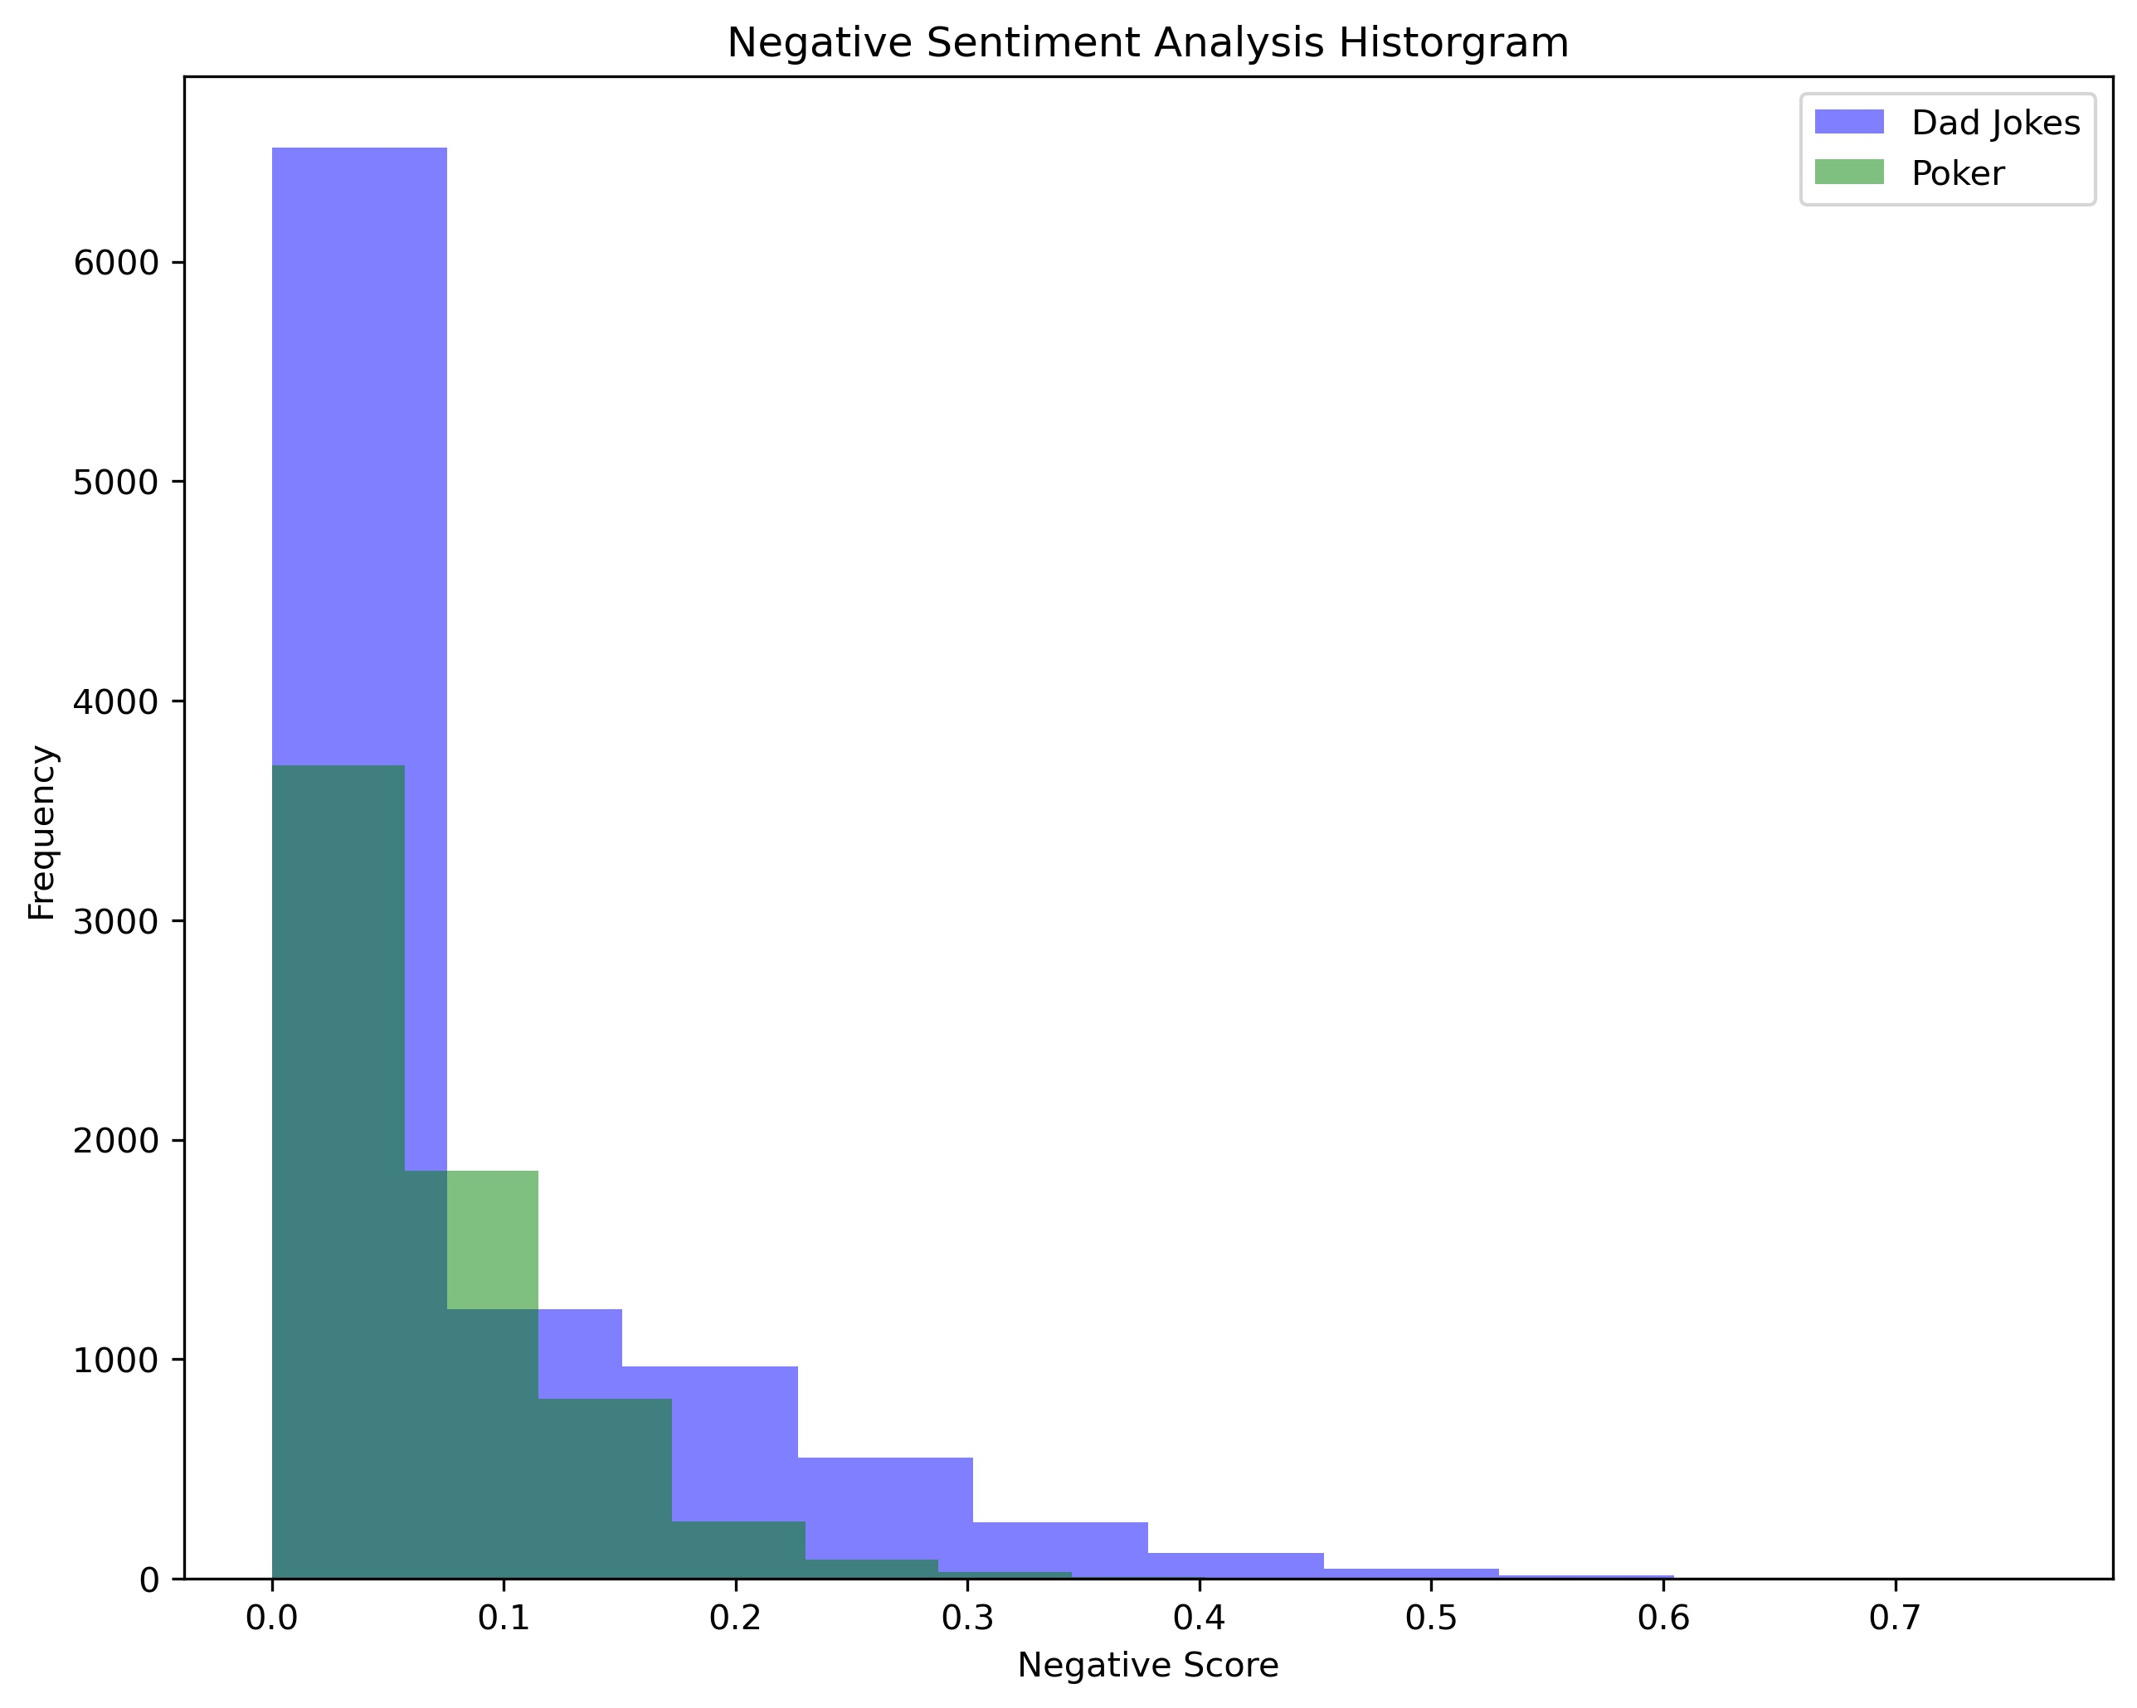
EDA – Feature Engineering

Slide 11
Modeling
Logistic Regression 97.6%
Random Forest 97.4%
Multinomial NB 97.3%
Lemmatization
Train/Test/Split
CV with Stop Words
*Overfitting Likely

Slide 12
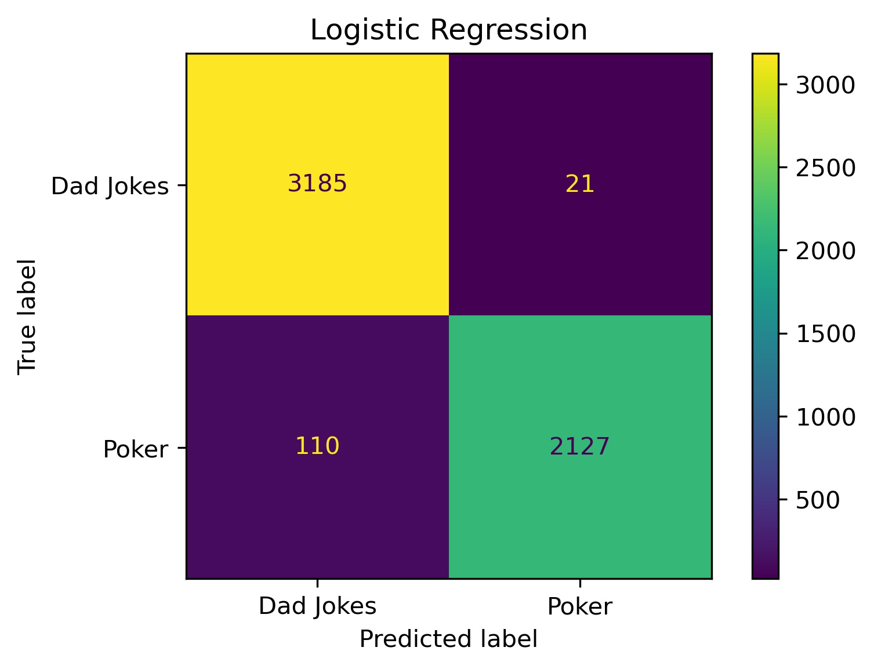
Conclusions – LogReg is Best
 | Baseline | Model Precision
Dad Jokes | 58.9% | 97%
Poker | 41.1% | 99%

Slide 13
In Conclusion
We should be Safe
Grab a flier of our Lemmatized, CountVectorized Poker Most Common Words
Stay Vigilent

Slide 14
Thank you for your Time!
Questions or Comments?

Slide 16
Additional Slides

Slide 17
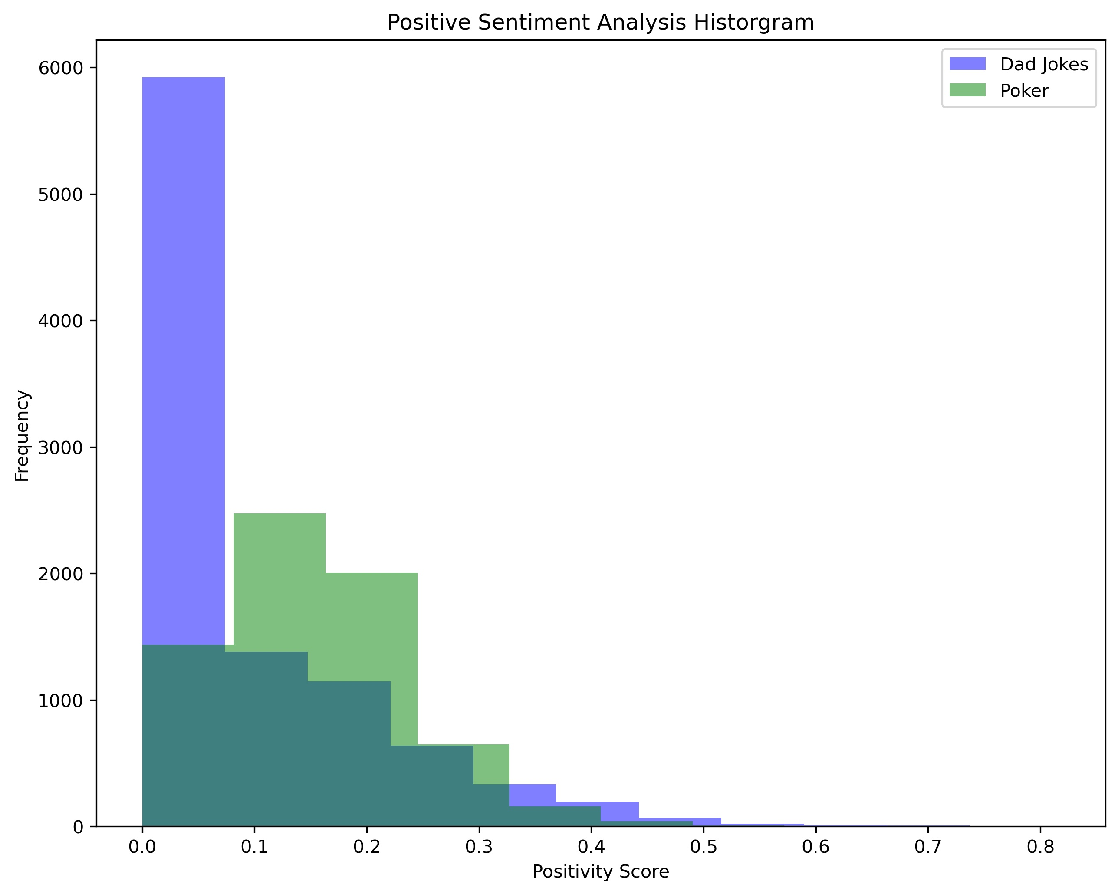
EDA – Feature Engineering

Slide 18
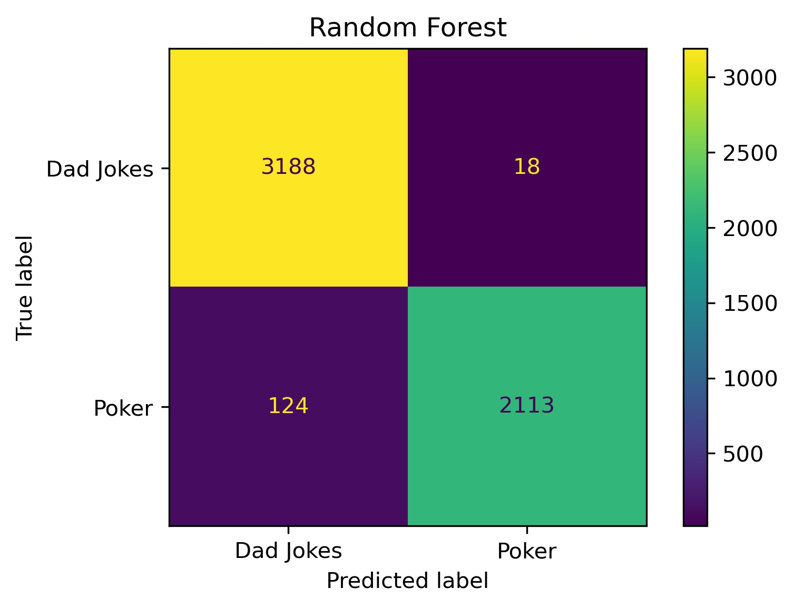
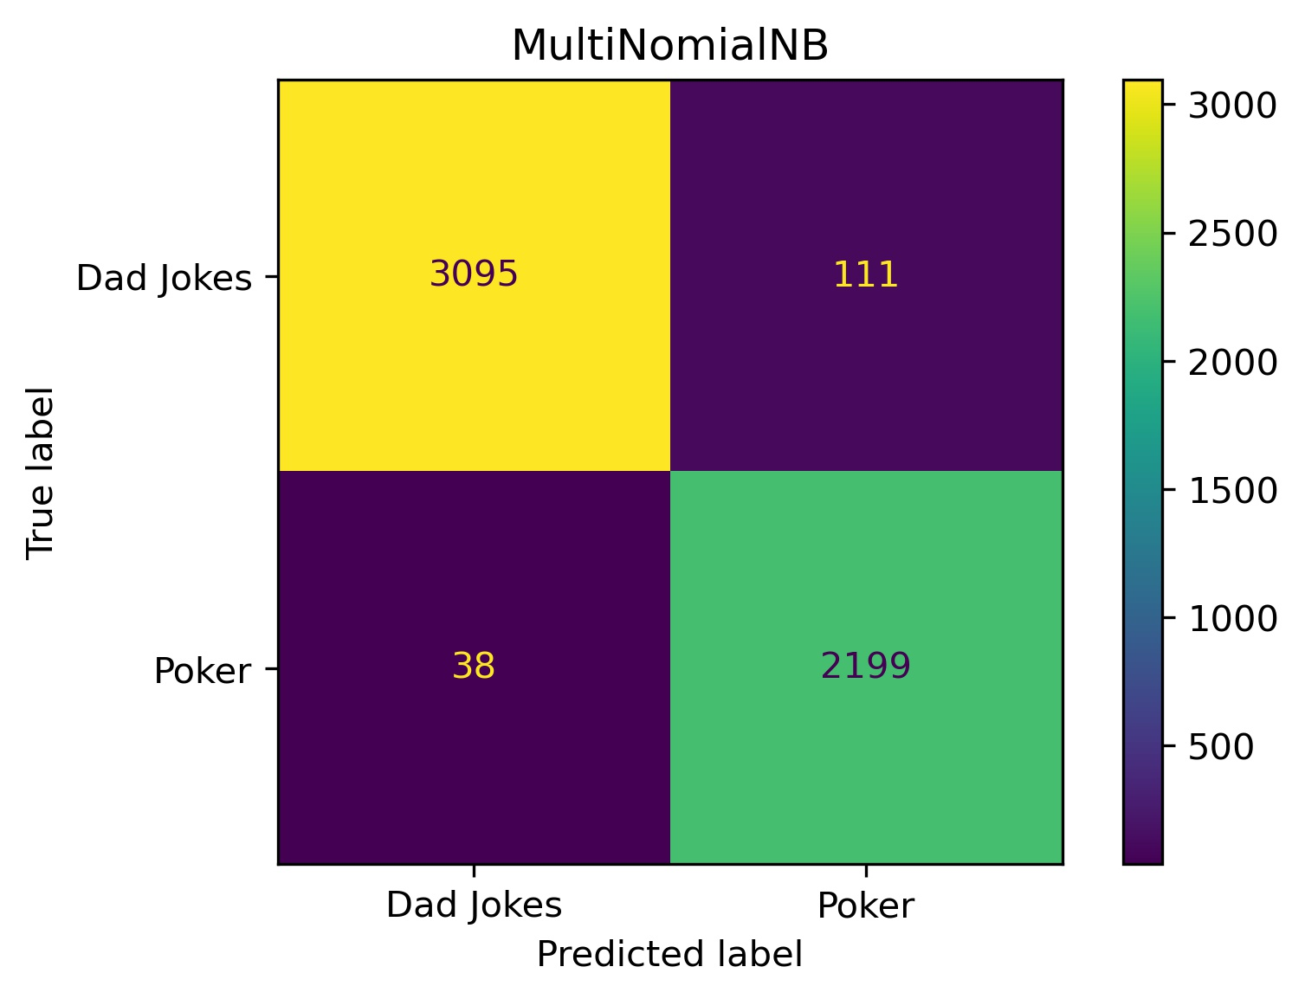
Conclusions

Slide 19
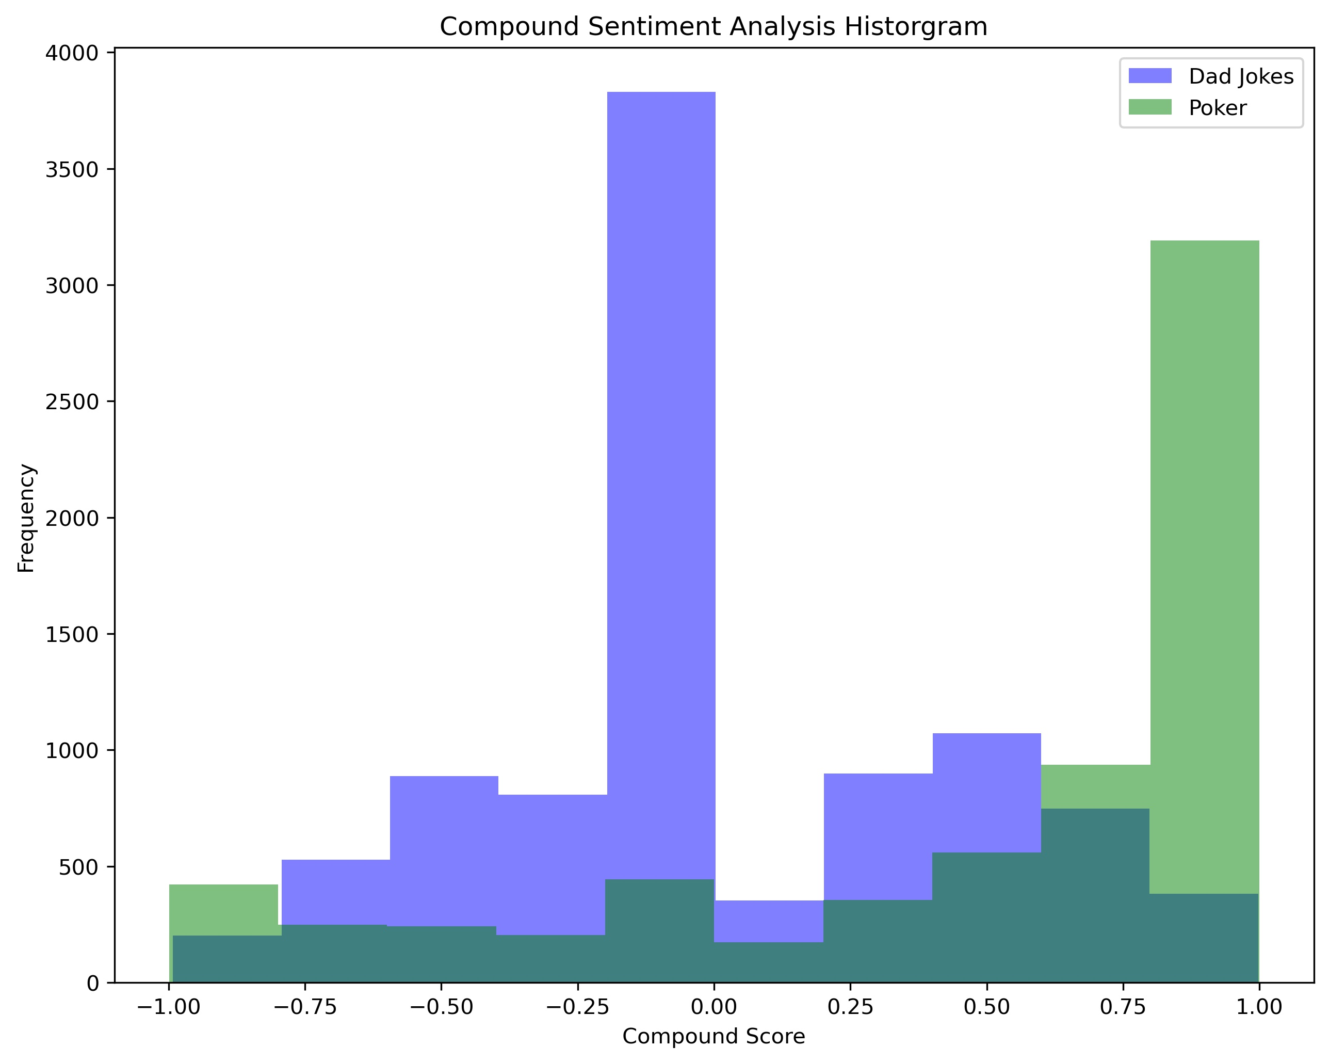
EDA – Feature Engineering

Slide 20
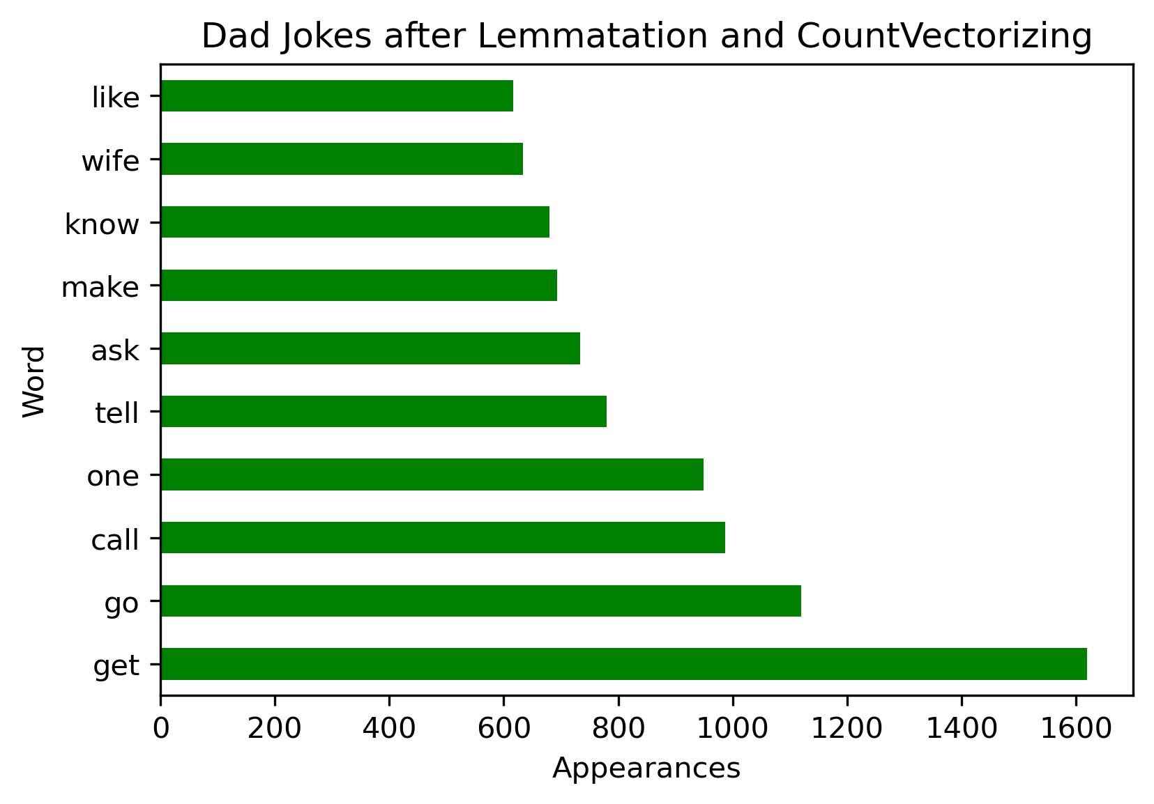
EDA – Feature Engineering

